Slide 1
Week-2
Session-2
Global business environment and economics
Globalizations and its advantages and disadvantages
-Capitalism and Global Capitalism
-Role of developing countries
-Challenges for developing countries
-Scope of globalization; Trend towards globalization
-Indicators of Globalization - FDI, FPI, World Trade, WTO, business restructuring, JIT, etc

Slide 2



Introduction
The process of globalization is changing the world—economically, politically, socially and culturally. Its impact is obvious in the everyday life of a typical household in a every country. Globalization leads to increased competition. This competition can be related to product and service cost and price, target market, technological adaptation, quick response, quick production by companies etc. When a company produces with less cost and sells cheaper, it is able to increase its market share

Slide 3
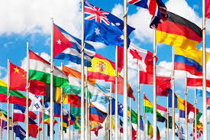
Learning outcomes
Having read this chapter you should be able
to understand the changing nature of business environment
to learn about the role of firms and governments in developing countries
to study the dynamics of economic framework in which firms operate

Slide 4
The Global Capitalism-Free Market Model
In simple teams Capitalism is an economic system characterized by private or corporate ownership of capital goods, by investments that are determined by private decision, and by prices, production, and the distribution of goods that are determined mainly by competition in a free market.
Global capitalism is capitalism that transcends national borders.

Slide 5
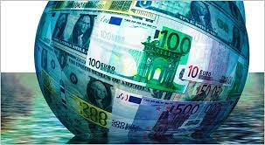
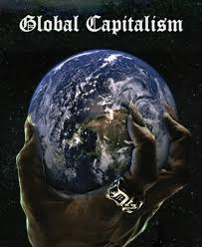
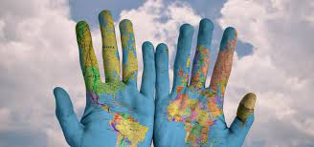
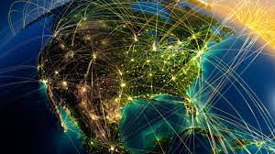
*
1-

Slide 6
Global Capitalism
Capitalism is often characterized by free market forces, profit and private property. This economic system manifests itself in two broad directions.
First, it leads to the development of large-scale multinational organizations.
Second, it rationalizes values, attitudes and behaviors with corporate goals and objectives to make abnormal profit.
*
1-

Slide 7

Problems with Global Capitalism
Volatility
Race to the bottom
*
Inequality
Degradation of Democracy
1-

Slide 8

Interesting Fact
“Of the 100 largest economies in the world, 51 are corporations, not countries”

Slide 9
ROLE OF DEVELOPING COUNTRIES
Create a new, inclusive international dialogue worldwide on the future of the global economy.
Develop a new international financial strategy that supports sustainable development through coordinated economic policies.
Redesign existing institutions of the global economy to make sustainable development rather than unlimited mobility of capital their goal.
*
1-

Slide 10
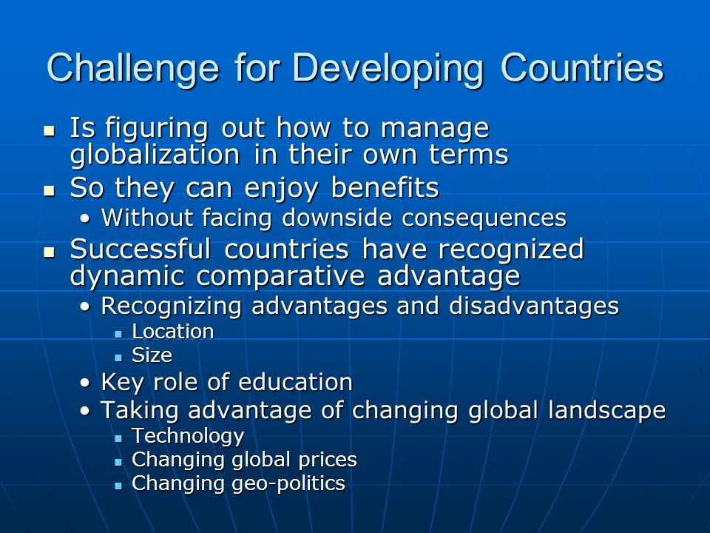
Challenge for Developing Countries

Slide 11
Scope of Globalization
Increased international trade
The growth of multinational corporations
The internationalization of finance
The application of new technologies in all these operations, especially computer and other information technologies
*
1-

Slide 12
Two macro factors seem to underlie the trend towards greater globalization
The decline in trade barriers to the free flow of goods, services, and capital that has occurred since the end of world war.
The technological change, particularly the dramatic developments that have occurred in recent years in communications, information processing and transportation technologies
*
1-

Slide 13
Globalization-Indicators
1. Foreign Direct Investments ( FDI) Investment in the real assets like factories, sales offices etc. by foreign fi rms falls under the category of Foreign Direct Investment. Total inflow of FDI has increased many folds during the last 15 years
*
1-

Slide 14
Globalization-Indicators
2. Foreign Portfolio Investments (FPI) Accompanying the FDI boom, foreign portfolio equity investment has also accelerated globally. Cross border transactions in bonds and equities have soared in most countries, from less than 10% of GDP in 1980 to 150–250% in the recent past
*
1-

Slide 15
Globalization-Indicators
3. Trade Since 1983, the pace of world trade has accelerated, reaching an average annual rate of 6 to 7%. This well outpaces the expansion of the world GDP, which has risen at an average of only 3.5% per year. However, the pace of world trade has been slower than the pace of world FDI, which has risen at above 15% per year since 1985
*
1-

Slide 16
Globalization-Indicators
4. Global Governance by International Organizations like World Trade Organization. This is clear from the three factors outlined below:
Deepening economic integration
Reduction of import duty rates
Increasing cooperation between countries for foreign investment
*
1-

Slide 17
Globalization-Indicators
5. Business Restructuring—Flexibility and Closeness to Market For many companies, this new environment of continuous change meant restructuring, and in particular:
Flexible, just-in-time production systems (to supply a greater variety of goods in smaller lots, and to offer rapid response to market impulses with minimal inventories)
Moving production closer to the consumer and securing access to the local market (replacing exports with Foreign Direct Investment)
Diversification of operations (shifting resources out of declining sectors or regions and into promising ones)
*
1-

